Slide 1
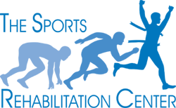
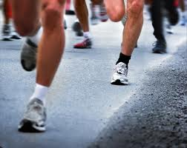
FREE Running Clinic: Injury Prevention & sports performance!
Training for an upcoming race or just want to improve your performance and prevent injury?
Expert speakers including: board certified sports/orthopedic physical therapists, podiatrist Dr. Perry Julien and Dr. Charles Peebles, and Big Peach Running Co. shoe specialist Steve DeMoss.
Learn exercises to improve your core stability and flexibility
Hear how to avoid common running injuries, the role of orthotics and proper shoe wear, common training mistakes and how to prevent them
The first 15 participants to sign up will receive a FREE gait screen with specific tips on how to improve your running performance and prevent injuries
Come dressed in your running gear as this clinic will be interactive!
Free Lululemon gift bag drawing!
Please join us for our clinic: Wednesday, November 7th 6-8pm The Sports Rehabilitation Center, Sandy Springs 5290 Roswell Road. Atlanta, GA 30342 Want to join? Sign up: Email Christynne Papincak, PT, DPT cpapincak@sportsrehabcenter.com or call (404) 477-8888

